Slide 1

Common Sense
A way to think & decide
By Vikas Mishra

Slide 2
Top 25 Best Countries
1. Canada 2. Japan 3. Germany 4. Switzerland
5. Australia 6. United States 7. New Zealand 8. United Kingdom
9. Sweden 10. Netherlands 11. France 12. Denmark
13. Norway 14. Singapore 15. South Korea 16. Italy
17. China 18. Finland 19. Spain 20. Belgium
21. Austria 22. United Arab Emirates 23. Ireland
24. Russia 25. India

Slide 3

India Ranking & Statistics
Parameter | Rank of India | Other Country status | Ranked by and published Date | Sourced
Top Best Country | 25th | Canada is at 1st Rank, and before India its Russia | USNews.com April 2021 | https://www.usnews.com/news/best-countries/slideshows/the-25-best-countries-in-the-world
Best Up & Coming Economies | 2nd Rank | 1st UAE, 3rd Egypt, 4th Singapore, & 5th China | USNEWS.com April 2021 | https://www.usnews.com/news/best-countries/movers-rankings
Manufacturing giant India claims the second spot

Slide 4
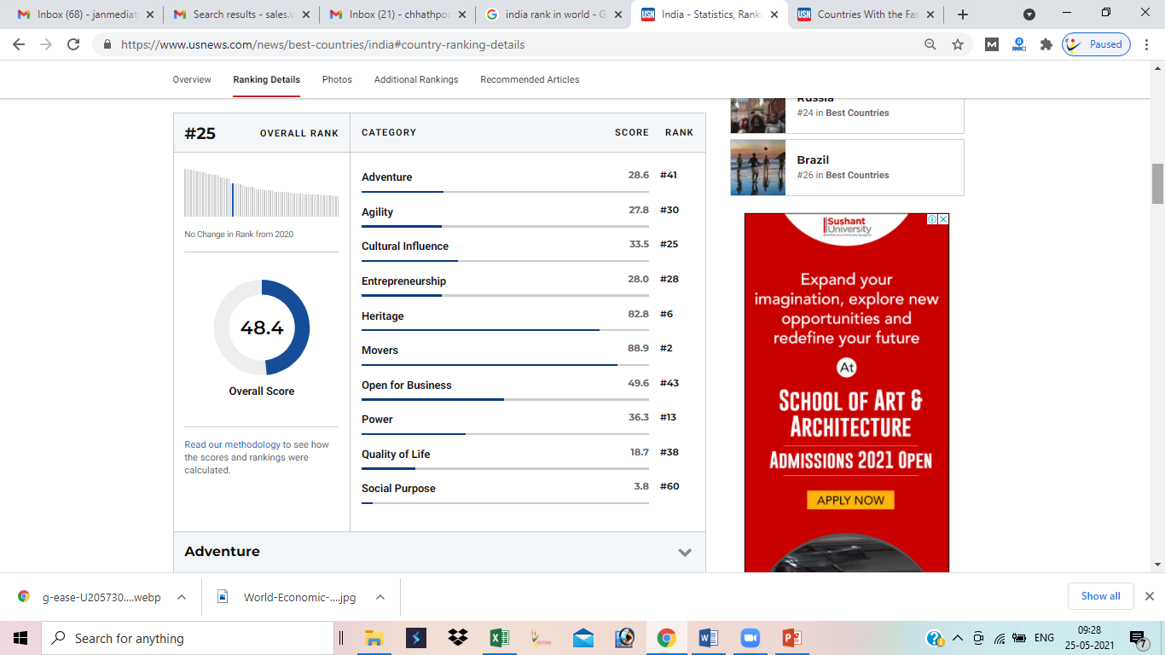
What make India at 25th Rank

Slide 5
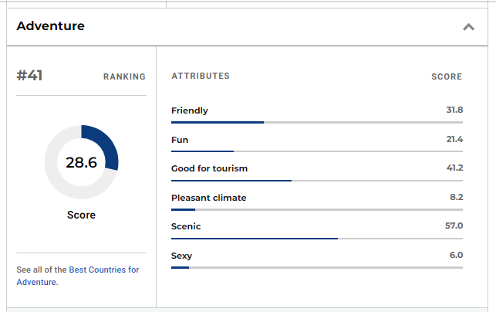
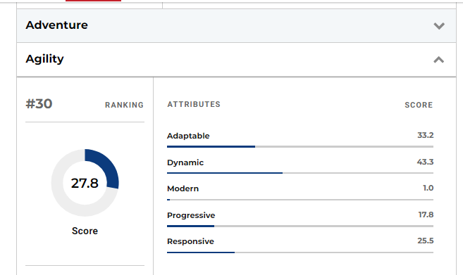
Adventure & Agility

Slide 6
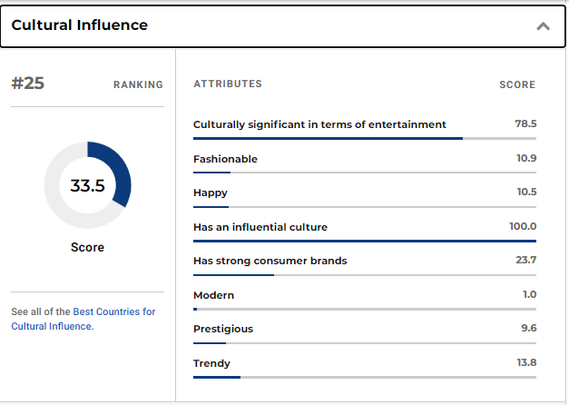
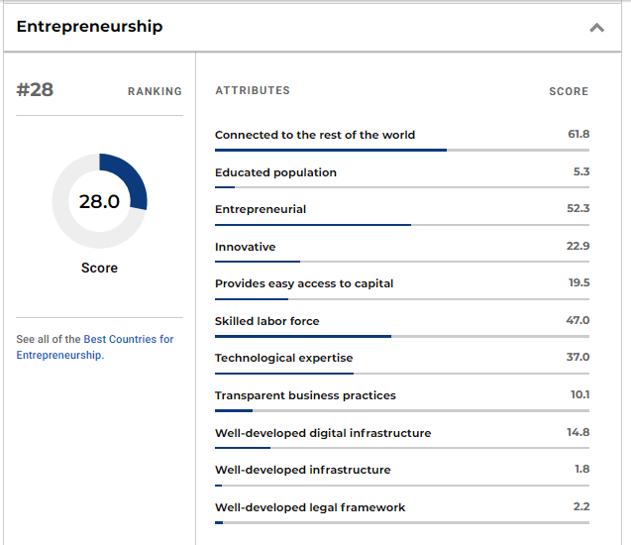
Cultural Influence & Entrepreneurship

Slide 7
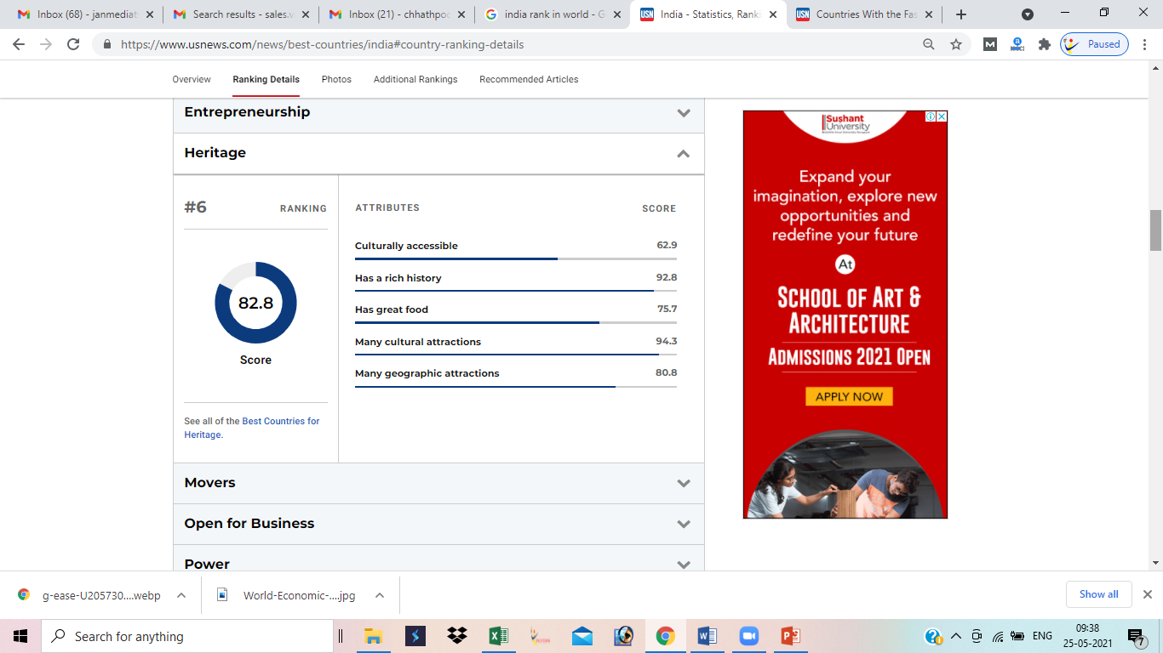
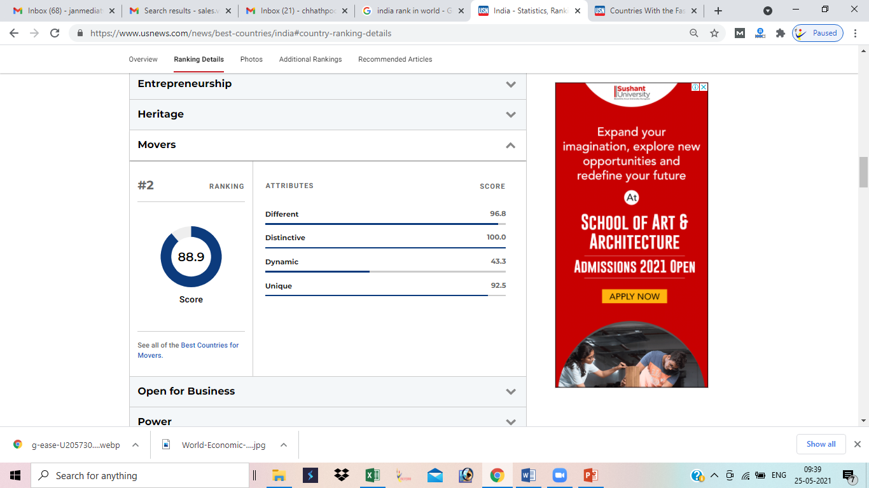
Heritage & Movers

Slide 8
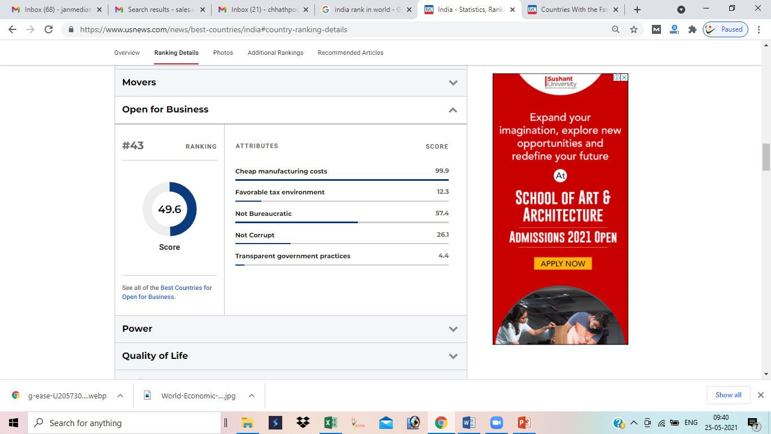
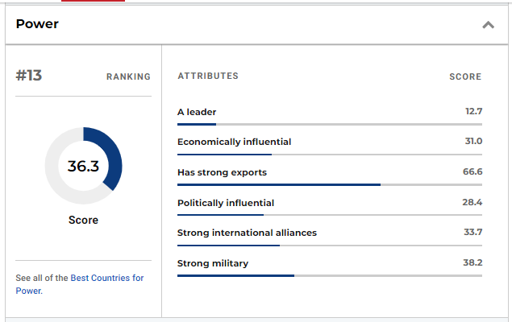
Open for Business & Power

Slide 9
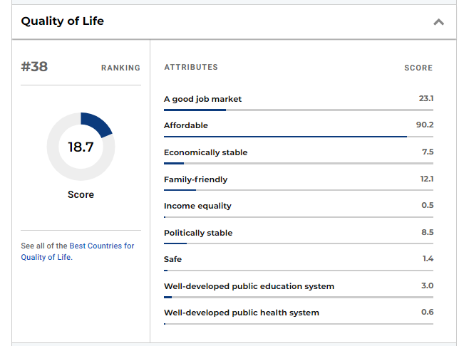

Quality of Life & Social Purpose

Slide 10
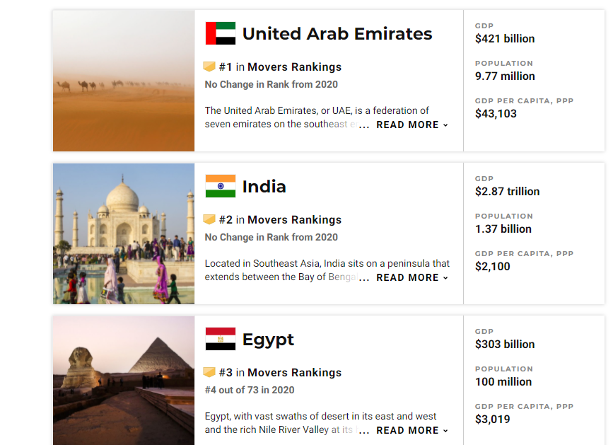
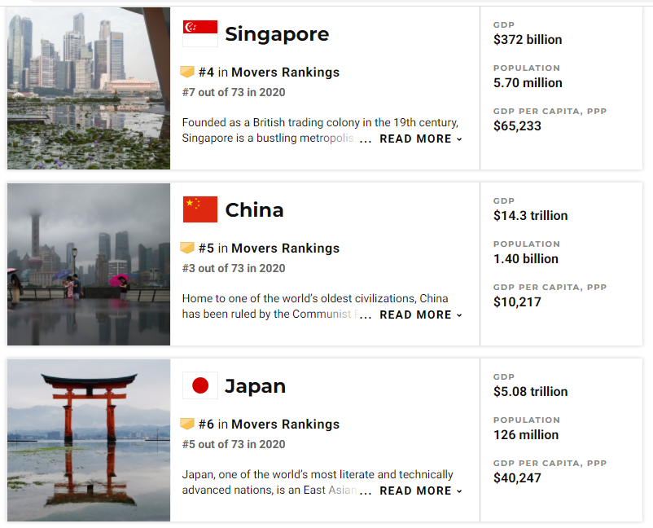
Comparative Figure by Movers Ranking

Slide 11
Few Top 10 Ranking
Column1 | Column2 | Column3 | Column4
Military | Entertainment | Cricket | Gross National Income
Mobile Phone in use | Electricity Production | Hockey | Number of Billionaries (131)-2018
Television broadcast station | Coal Production & Consumption | Chess | GDP- 2019 – US$8.681 trillion
Railway Transportation | Steel Production | Badminton | Intentional Homicide - Crime
Net Migration | Epidemiology of diabetes mellitus | English Speaking Population | Gun - Ownership
Population | Area

Slide 12
Ranked with Military
Parameter | Rank | Source | Remarks
Military Expenditure | 3/186 | Stockholm International Peace Research Institute | 2019 – $70.1bn or 2.24% of GDP
Military Strength | 4/20 | Credit Suisse | 2019
Active Troops | 1/171 | International Institute for Strategic Studies | 1,395,100 active troops
Total Troops | 2/171 | International Institute for Strategic Studies | 4,941,600

Slide 13
India with Worst Ranking
Column1 | Column2 | Column3 | Column4
Education Index | Global Hunger Index* | Literacy Rate | Human Capital Index
World Happiness Report* | Human Development Index* | Programme for International Student Assessment* | Cigarette Consumption per Capita*
Social Progress Index | Where-to-be-born Index* | Urbanization by country* | Global Peace Index*
Per capita GDP (nominal)- 2019 – US$2,104 | Intellectual property Index* | World Competitiveness | Index of Economic Freedom*
Quality-of-life index* | ICT Development Index* | Internet users (pct of population) | Olympic All time Medal's Tally
Corruption Perceptions Index | Press Freedom Index | Soft power-Politics* | Environmental Performance Index*

